Slide 1
Using a joystick to control two motors
-Digital electronics 2 project
Created and presented by:
Nolwenn Violette and Frederick Jennings

Slide 2
Task and preparation
Our task was to control several SG90 servo motors using HW-504 analog joysticks.
Started by finding the datasheets for both components.
We developed two simple test code for testing
We agreed on certain specifications:
That we’d use one joystick for two motors
Each motor would be for one axis
If we had time we wanted different modes

Slide 3
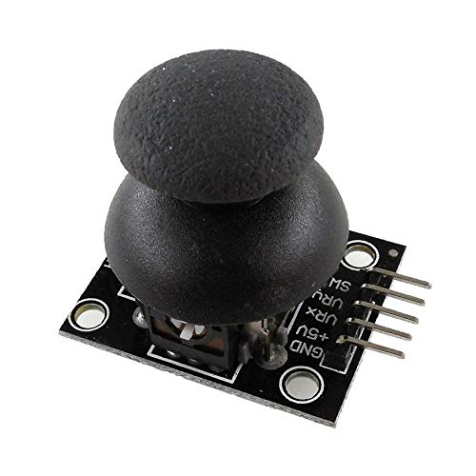
Joystick
The joystick sends two analog signals
The ADC can only use 1 channel at once
Had to use a finite state machine to change signals.

Slide 4

Servo motors
The motors use PWM signal.
Two motors requires a PWM each.
The length of the duty cycle dictates the angle to which it turns.
One timer used to generate both signals.

Slide 5
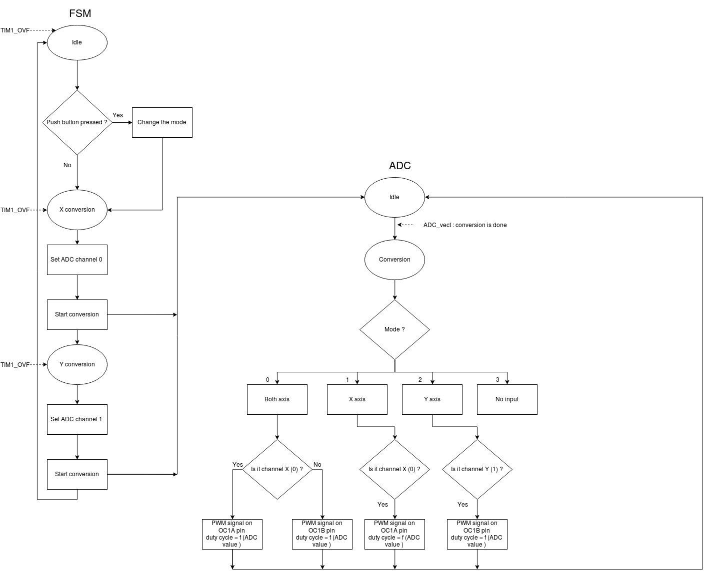

Slide 8
Additional features
We add debouncing as the mode switching wasn’t working properly.

Slide 9
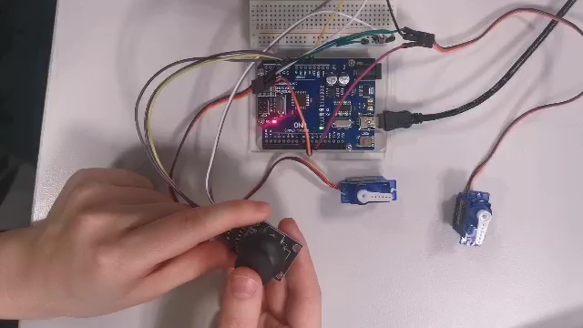
Video demonstration

